Slide 1
What’s Cooking? (Food Dataset)

Slide 2
Objective
Classification:
Predict cuisine based on given ingredients

Slide 3
Exploratory Data Analysis

Slide 4
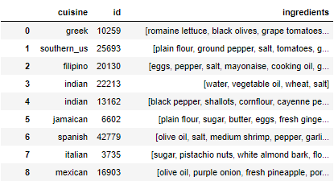
Introduction to dataset
Notes:
This is how the dataset looks like: very simple with only 3 columns, namely cuisine, id and ingredients. So basically, 1 row of data would correspond to a recipe of the respective cuisine and its ingredients.

Slide 5
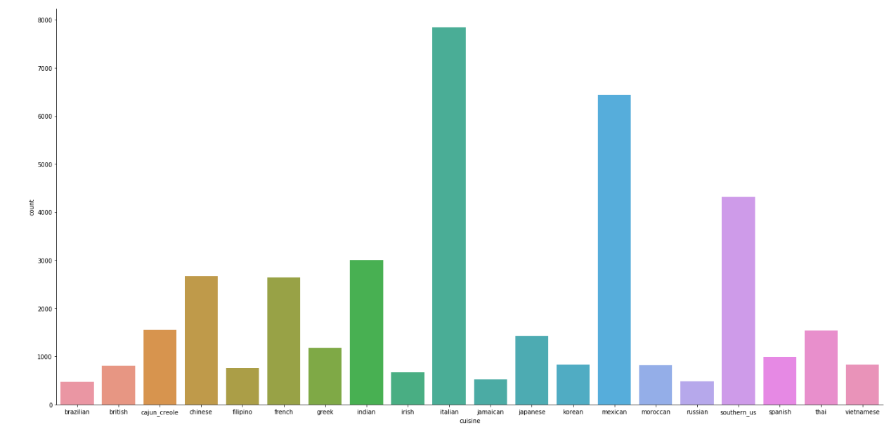
Cuisine Frequencies
Notes:
There are a couple of over-represented cuisines (Italian - 7838, Mexican - 6438 and to some extent Southern_US - 4320). This might bring some fake accuracy on our classification models because these will try to fit on the most represented cuisines.

Slide 6
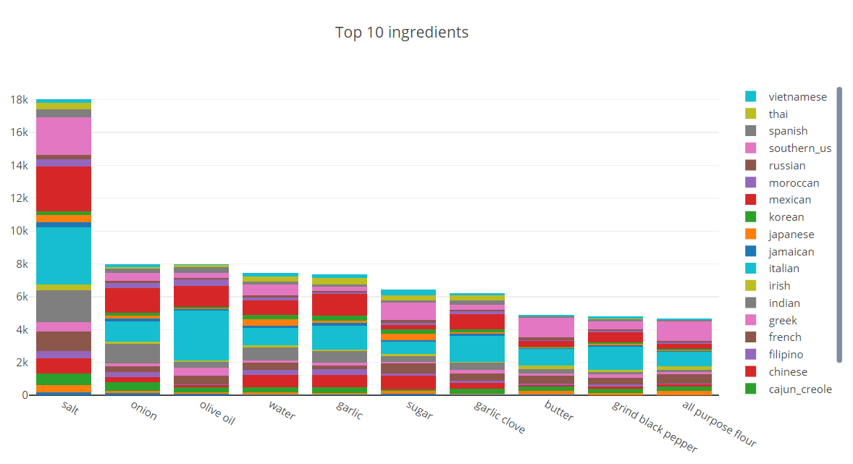
Notes:
Most if not all cuisines have these ingredients within their recipes. Due to this overlap, trying to classify a cuisine based off these ingredients is not ideal, as the confidence level would not be very high. Furthermore, this list is not exhaustive, due to the sheer amount of recipes per cuisine. Hence, an expert in field of food can help us to figure out which ingredients exist in each cuisine and allow us to better classify the cuisines.

Slide 7
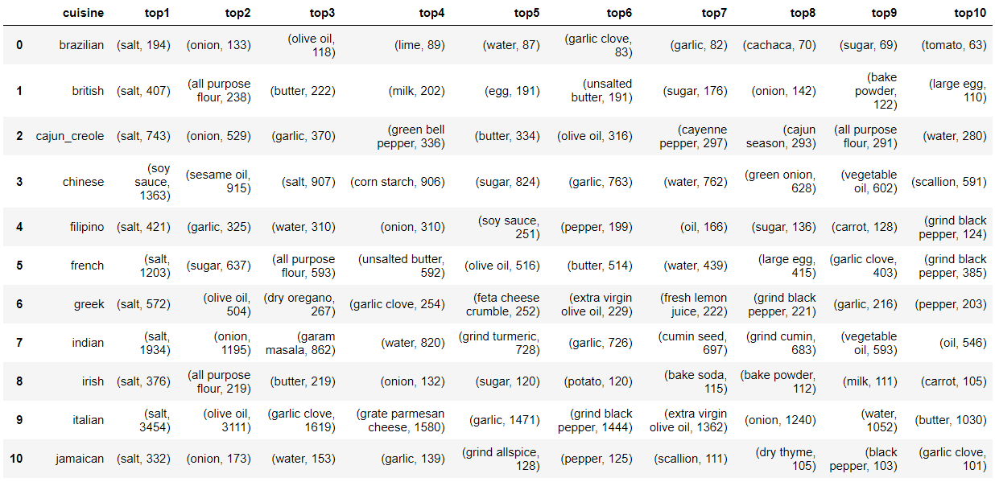
Top 10 Ingredients Per Cuisine
Notes:
Results are about the same as the previous slide (salt, oil, pepper, sugar), but you can start to pick out a few special ingredients. E.g. soy sauce and sesame oil is more frequently used in asian cuisines, sake in Japanese cuisines, feta cheese crumbs in Greek cuisines, garam masala in Indian cuisines, ground ginger in Moroccan cuisines and avocado in Mexican cuisines. These ingredients might play a role in identifying the cuisines.

Slide 8
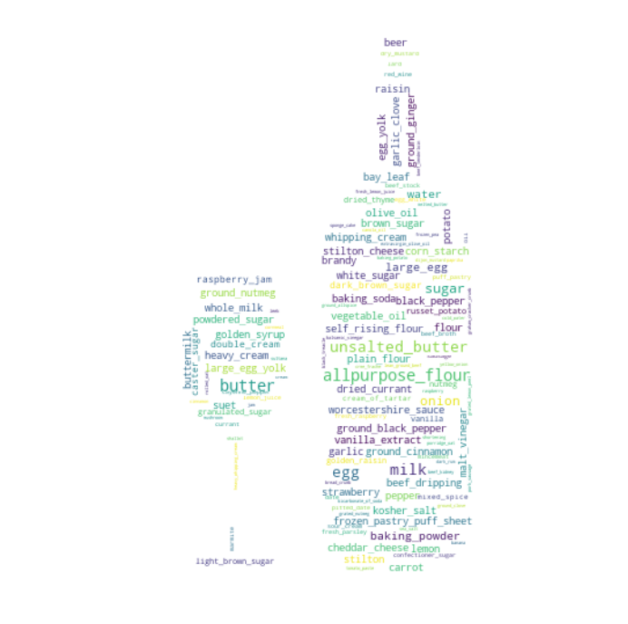
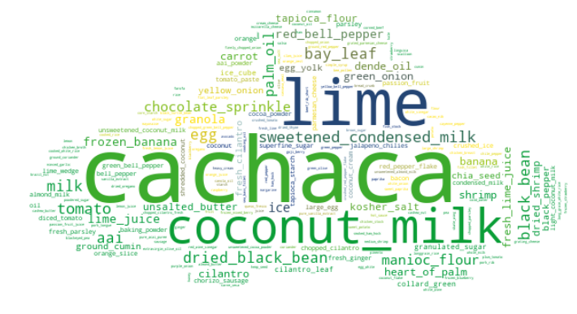
Word cloud of Rarer Ingredients (TF-IDF)
Notes:
TF-IDF: Term Frequency - Inverse Data Frequency

Slide 9
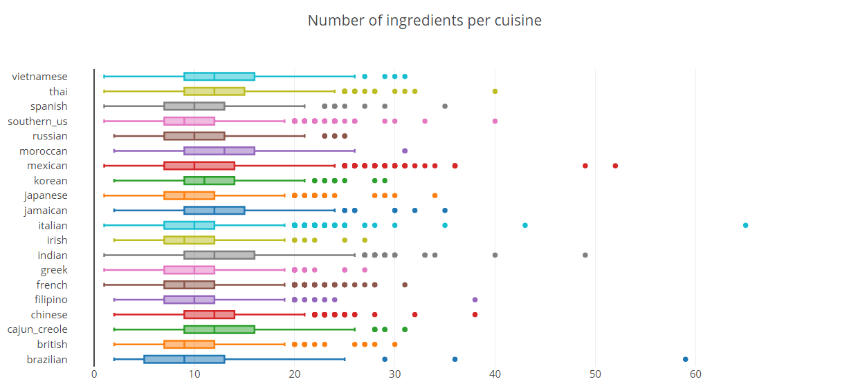
Notes:
Originally, we also wanted to use the number of ingredients per cuisine as a predictor. However, due to the similarities in ingredient counts between all the cuisines (median between 9 to 12), we decided that it would not serve as a good predictor, as the confidence level in predicting the cuisine would not be very high.

Slide 10
Data Preparation

Slide 11
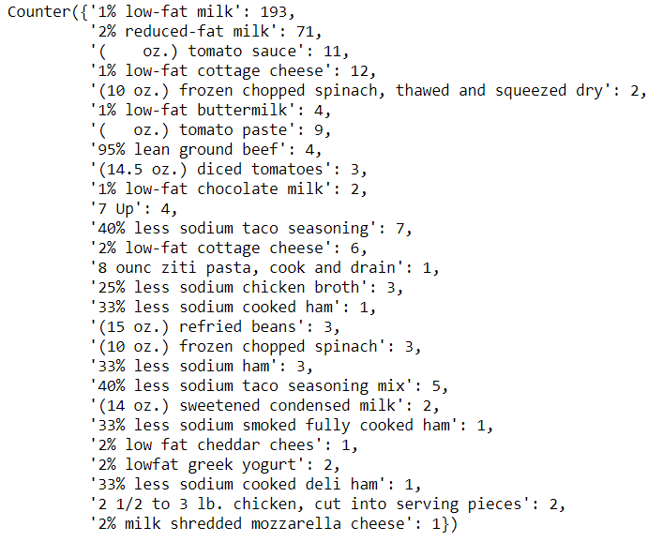
Cleanliness of Data
Mostly clean, with a few unwanted characters

Slide 12


Further Cleaning of Data
Lowercase
Remove special characters and numbers
Remove measurements (‘oz.’, ‘lb.’)
Lemmatize ingredients with noun and verb POS tag

Slide 13

Data Preprocessing
One Hot Encoding
Random Train-Test Split (80-20)

Slide 14
Models

Slide 15
Methods
Sklearn Models
Neural Network

Slide 16
Sklearn Models
Models | Test Accuracy
Random Forest | 0.6670%
MultinomialNB (Naive Bayes) | 0.6866%
BernoulliNB (Naive Bayes) | 0.7240%
SGD Classifier | 0.7596%
Linear SVC | 0.7609%
Logistic Regression | 0.7752%

Slide 17
Neural Network (Embeddings)
Input
Embedding
Global_average_pooling
Dense 1
Dense 2
Output

Slide 18
Hyper parameters
Learning Rate
L2 Regularization
Vector Size
Activation functions
Optimizer
Aim to maximise validation accuracy

Slide 19
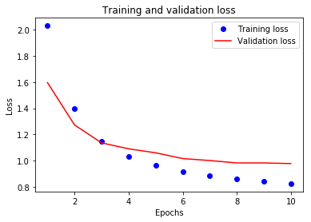
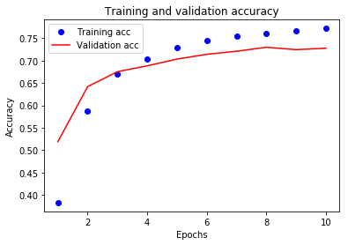
Training and validation graphs

Slide 20
Instructions for tensorboard
In Console, type:
tensorboard --logdir=dsai_project/logs
Will see this: (TensorBoard 1.13.1 at http://DESKTOP-DPQ9TBV:6006 (Press CTRL+C to quit))
In Browser, type:
http://localhost:6006/
When done, press ctrl + c

Slide 21
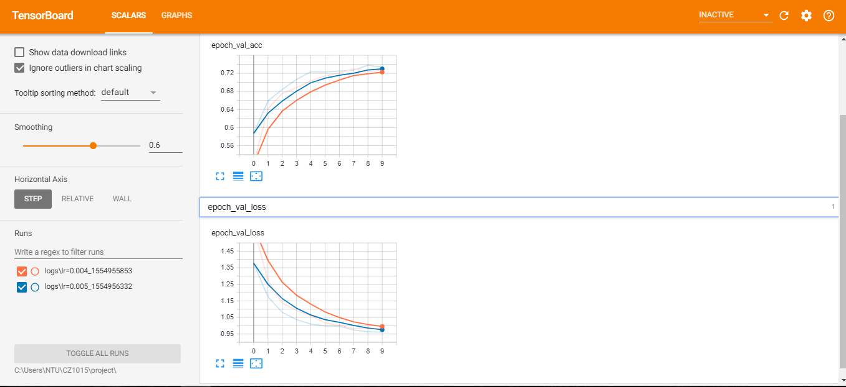
Tensorboard

Slide 22
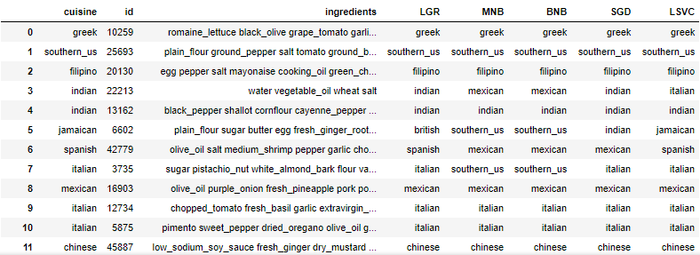
Predict

Slide 23
Things Learnt
Usage of libraries and functions eg.(nltk,tensorflow,sklearn,wordcloud,regex)
Application of different models
K-fold cross validation
Processing textual data

Slide 24
Outcome
Able to predict cuisine based on given ingredients after processing the text data

Slide 25
Job scope
Ke Xiang: Visualisations Data processing Random Forest K-Fold Cross Validation | Alexander Lim: Sklearn models Data processing Neural network Word cloud TFIDF

Slide 26
Thank You!

